Slide 1
Standard Bank
Data analysis and prediction of loan defaulters

Slide 2
Agenda
Data Science Lifecycle
Project Overview
Data
Analysis
Modelling
Model Evaluation
Recommendations

Slide 3
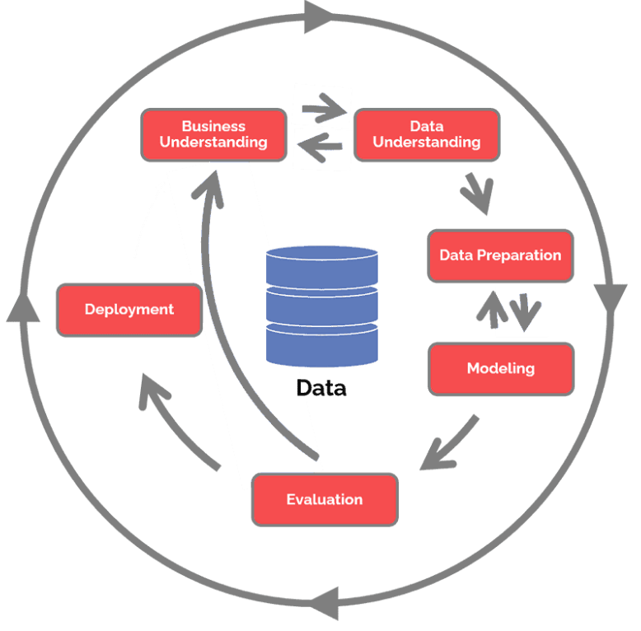
Data Science Lifecycle
Business understanding – What does the business need?
Data understanding – What data do we have / need? Is it clean?
Data preparation – How do we organize the data for modeling?
Modeling – What modeling techniques should we apply?
Evaluation – Which model best meets the business objectives?
Deployment – How do stakeholders access the results?

Slide 4
Project Overview
Business Problem: Standard Bank is embracing the digital transformation wave and intends to use new and exciting technologies to give their customers a complete set of services from the convenience of their mobile devices. As Africa’s biggest lender by assets, the bank aims to improve the current process in which potential borrowers apply for a home loan. The current process involves loan officers having to manually process home loan applications. This process takes 2 to 3 days to process, upon which the applicant will receive communication on whether or not they have been granted the loan for the requested amount.
Business Objective: To improve the process, Standard Bank wants to make use of machine learning to assess the creditworthiness of an applicant by implementing a model that will predict if the potential borrower will default on his/her loan or not, and do this such that they receive a response immediately after completing their application.

Slide 5
Process Overview
Data Collection: We will use the dataset given to us which is in a csv format.
Data Understanding: We will get familiar with the contents of our data and basic understanding and statistics of data.
Data Visualization: We will uncover some insights about our data.4
Data Preprocessing: We will perform necessary transformations on our data so that it will be ready for training.
Model Training: We will train our dataset using different ML algorithms.
Model Evaluation: We will evaluate our model performance.
Test Model: Finally, we will test our model on unseen data and see the predictions.

Slide 6
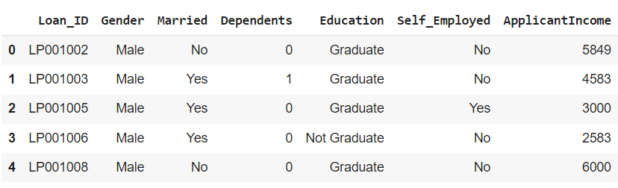
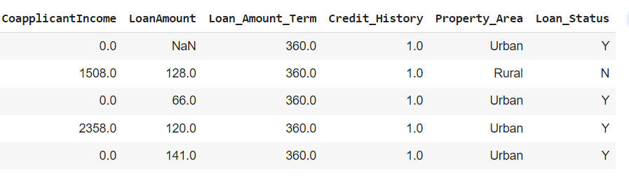
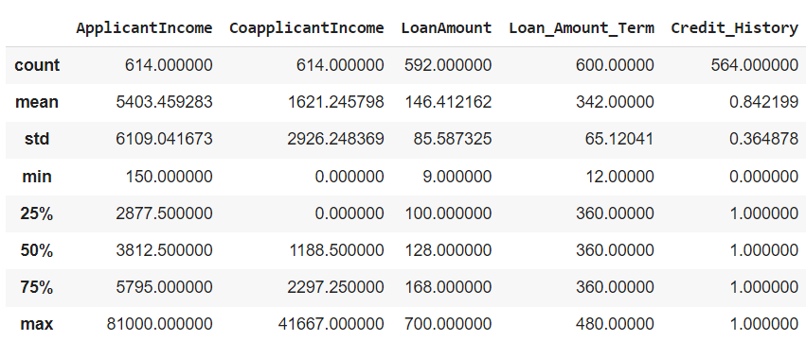
Data
There are 2 datasets given: train data with 614 records and 13 columns and test data with 367 records and 12 columns.
Target Column – Loan_Status.
There are 6 columns which have categorical data and rest have numerical data.
There are some columns which have missing values but there are no duplicate records in both train and test dataset.

Slide 7
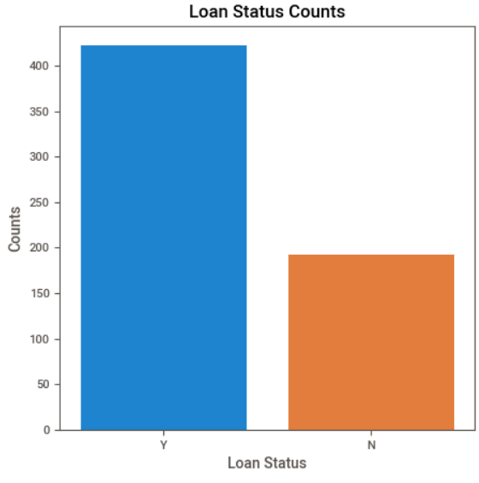
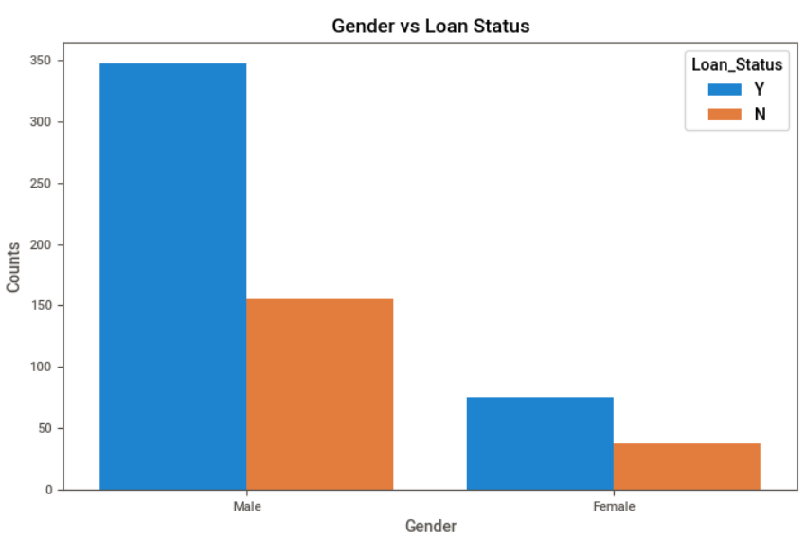
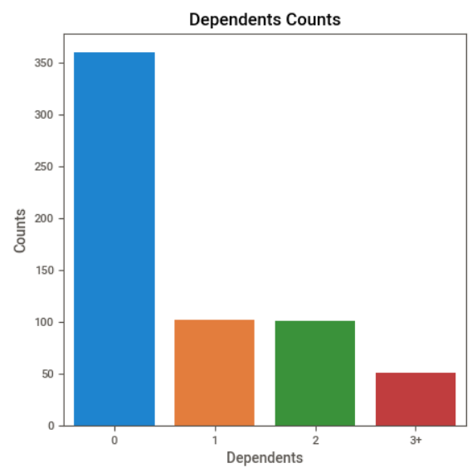
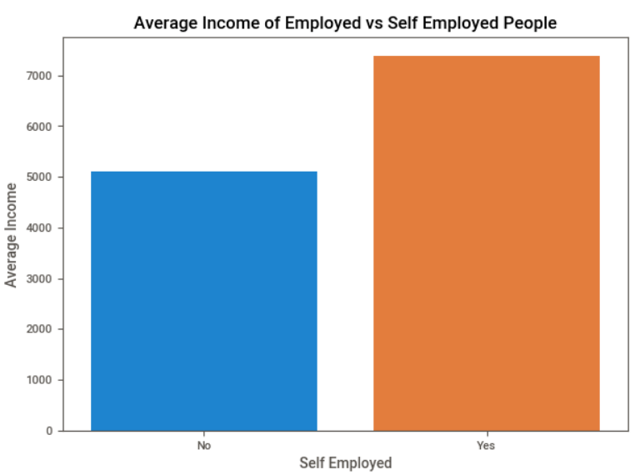
Analysis
There are 422 – 68.72% records with loan approved status and 192 - 31.27% records with load denied status.
Out of the 502 Males, 347 - 69.12% are with Loan Status: Approved and 155 - 30.87% are with Loan Status: Denied and out of 112 Females, 75 - 66.96% are with Loan Status: Approved and 37 - 33.03% are with Loan Status: Denied.
Out of the total 614 applicants, 360 - 58.63% have no dependents and 254 - 41.36% have dependents.
The average income of Self Employed applicants is 7380.82 and for employed applicants it is 5098.68.

Slide 8
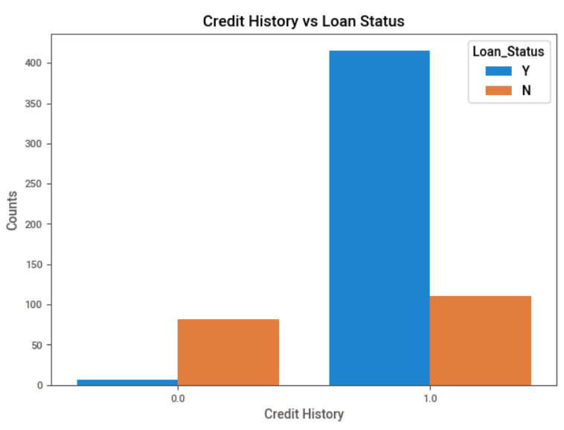
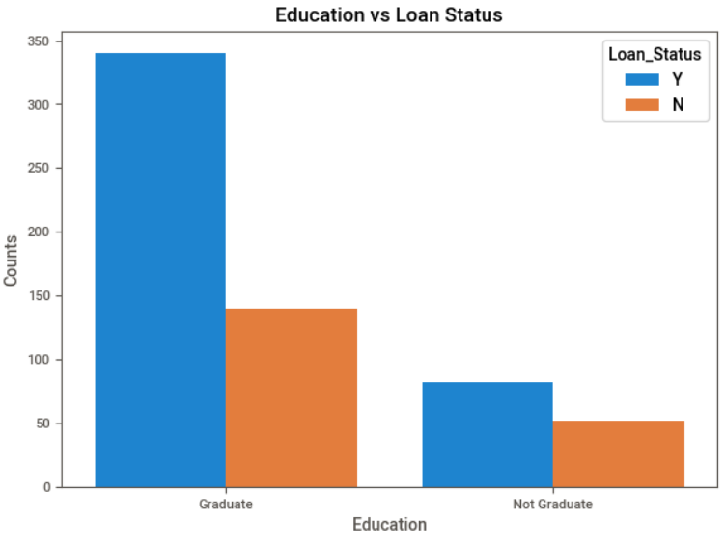
Analysis
There are total of 525 - 85.50% applicants with a Credit History and 89 - 14.49% with No Credit History. Out of 525 applicants with a Credit History, 415 - 79.04% have Loan Status: Approved and 110 - 20.95% have Loan Status: Denied. Out of the 89 applicants with no Credit History, 7 - 7.86% have Loan Status: Approved and 82 - 92.13% have Loan Status: Denied.
Out of 480 Graduate applicants, 340 - 70.83% have Loan Status: Approved and 140 - 29.16% have Loan Status: Denied. Out of 134 Not Graduate applicants, 82 - 61.19% have Loan Status: Approved and 52 - 38.80% have Loan Status: Denied.

Slide 9
Modelling and Evaluation
AutoML : Model Score – 94.29% and Model Accuracy – 78.04%. This shows that the model is overfitting.
Logistic Regression: Model Score – 81.87% and Model Accuracy – 78.86%. This is the best model.
AdaBoostClassifier: Model Score – 85.94% and Model Accuracy – 73.17%. This model is also overfitting.
Decision Tree: Model Score – 100% and Model Accuracy – 67.47%. This model is also overfitting.
Random Forest: Model Score – 100% and Model Accuracy – 72.35%. This model is also overfitting.
XGBoost: Model Score – 88.59% and Model Accuracy – 75.60%. This model is also overfitting.

Slide 10
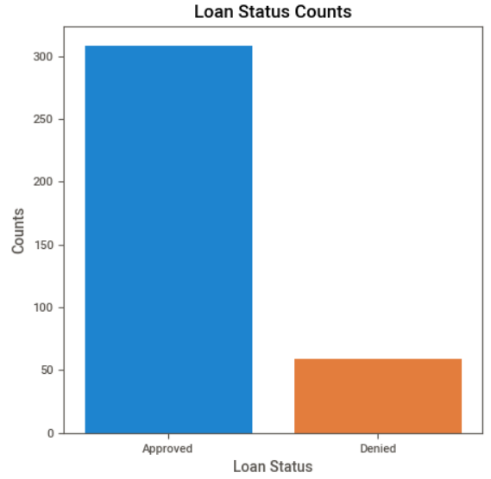
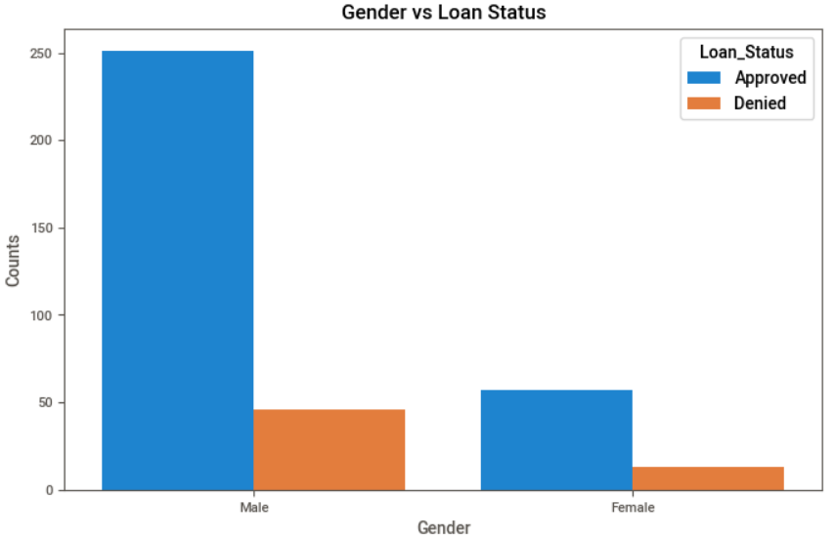
Prediction on Test Data
In the test data after prediction, we found that there are 308 - 83.92% applicants whose Loan Status is Approved and 59 - 16.07% applicants whose Loan Status is Denied.
Out of 297 Male applicants in test data, 251 - 84.51% have their Loan Status: Approved and 46 - 15.48% have their Loan Status: Denied. Out of 70 Female applicants, 57 - 81.42% have their Loan Status: Approved and 13 - 18.57% have their Loan Status: Denied.

Slide 11
Summary
In the training data, there are 68.72% records with Approved and 31.27% records with Denied Loan Status. So the data is imbalanced.
Considering the Gender there is no significant difference in whether a person will default or not as both gender has nearly equal percentage of loan defaulters and can be dropped during model training.
After initial analysis, we found that applicants with No Credit History are more likely to default.

